Slide 1

N e o n
A PRESENTATION BY
CHANDRAKANT SM, SUSWIT
HULIGEMMA AJAY JEEVAN
HUBLI KEONICS

Slide 2
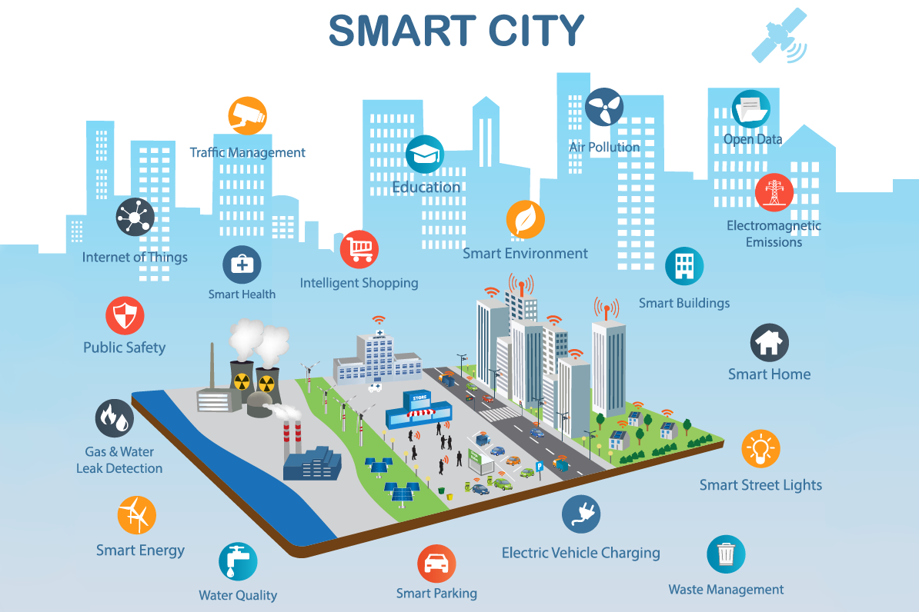

Slide 3
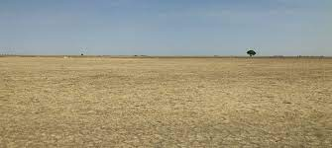
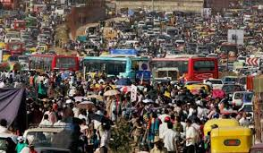

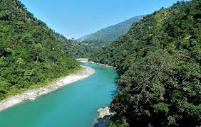
LAND SELECTION:5000 acres and population of 5,00,000
PLAIN LANDS: TALENT CROWDED CITIES
REACHABILITY WATER AVAILABILITY

Slide 4
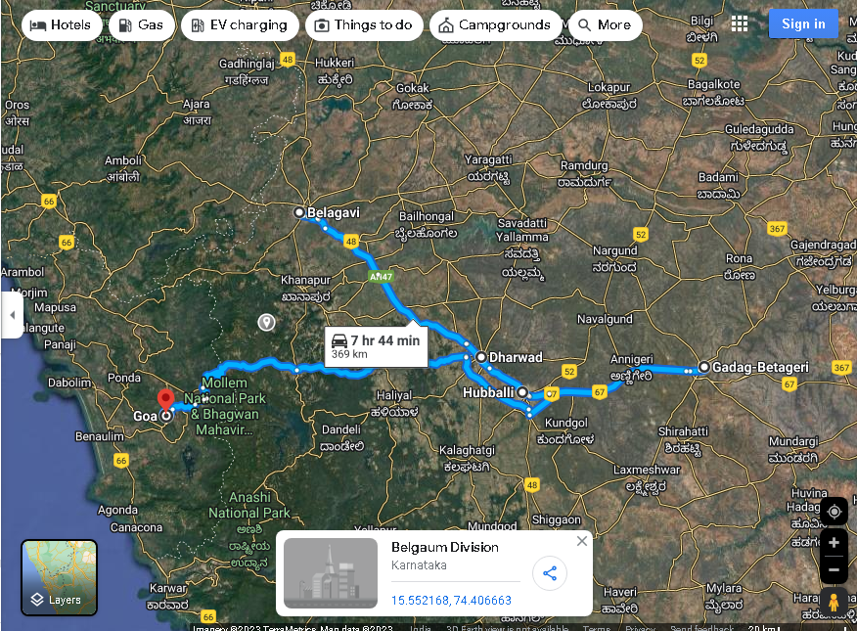
Neon
Neon is smartcity spread across 5000 acres , its adjacent to Hubli and dharwad highway , NH4, which connects Mumbai with Bangalore .Neon is 2kms from Hubli airport,90 kms from belguam and Well connected by rail, which runs parallel to NH4.
Neon is going to come up, near hubli dharwad with a population of a 50 lacs , within 80km radius .

Slide 5
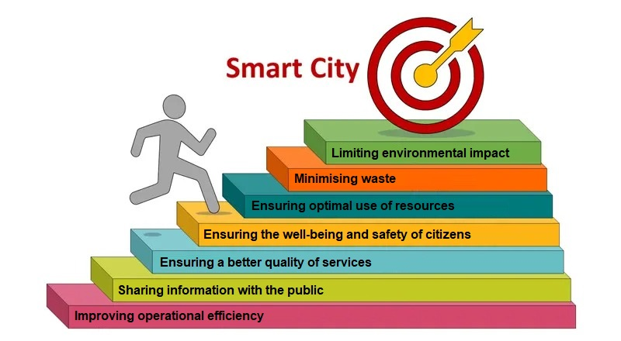
Objectives of smart city

Slide 6
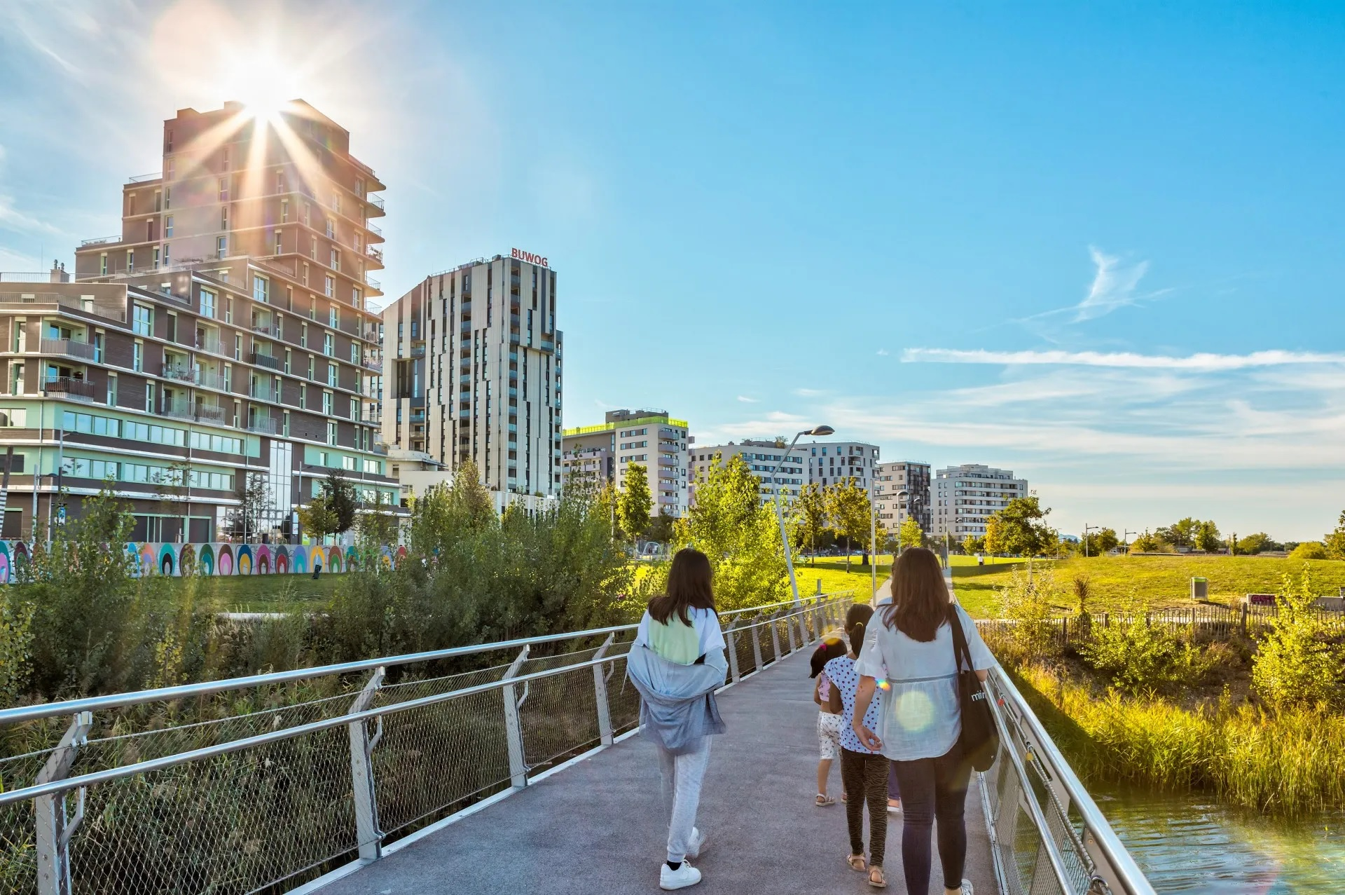
Infrastructure
With smart infrastructure, we are shaping an ecosystem that connects the real world with digital world

Slide 7
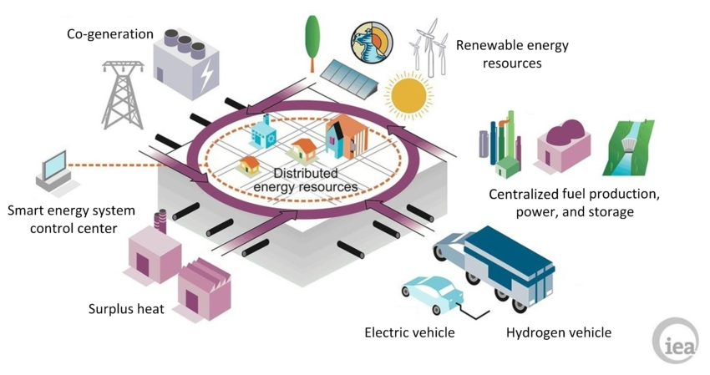
Renewable energy

Slide 8
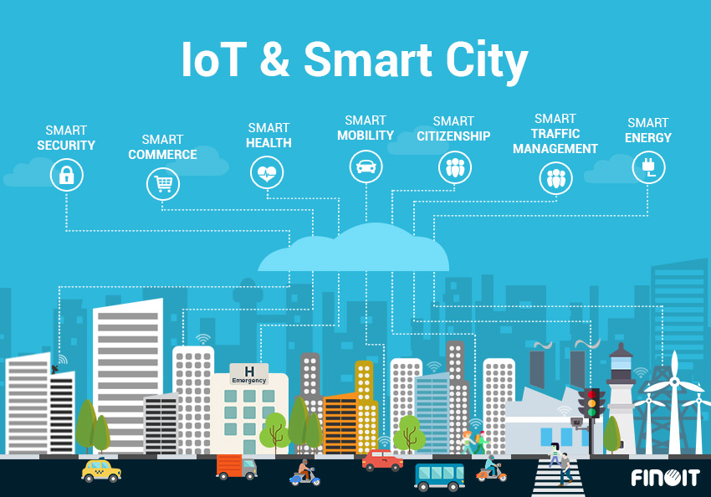

Slide 9
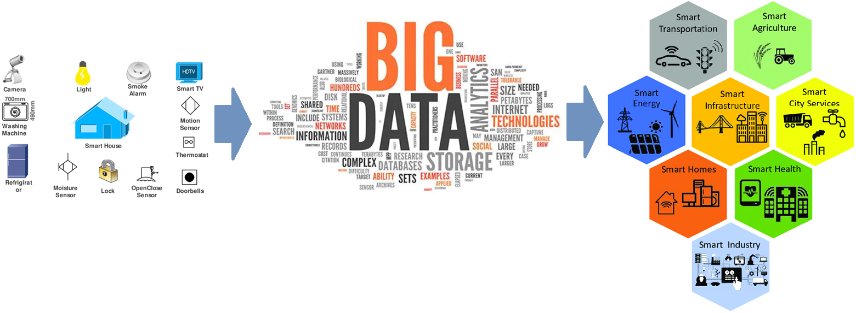

Slide 10
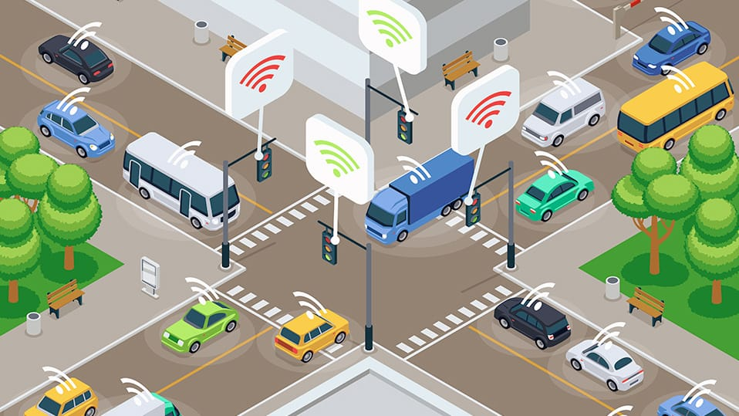
Intelligent transport systems

Slide 11
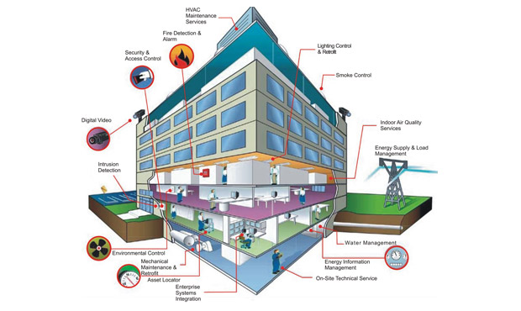
Smart buildings

Slide 12
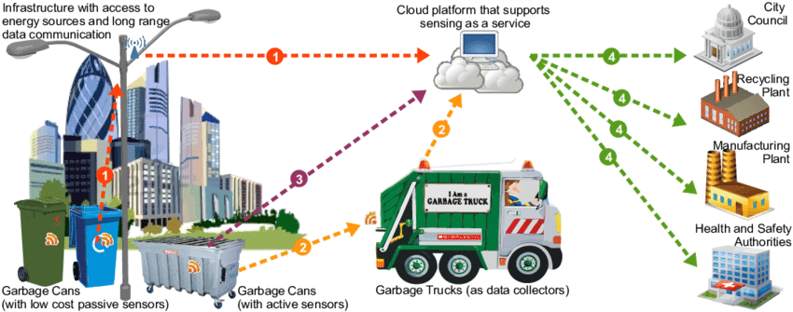
Smart waste management

Slide 13
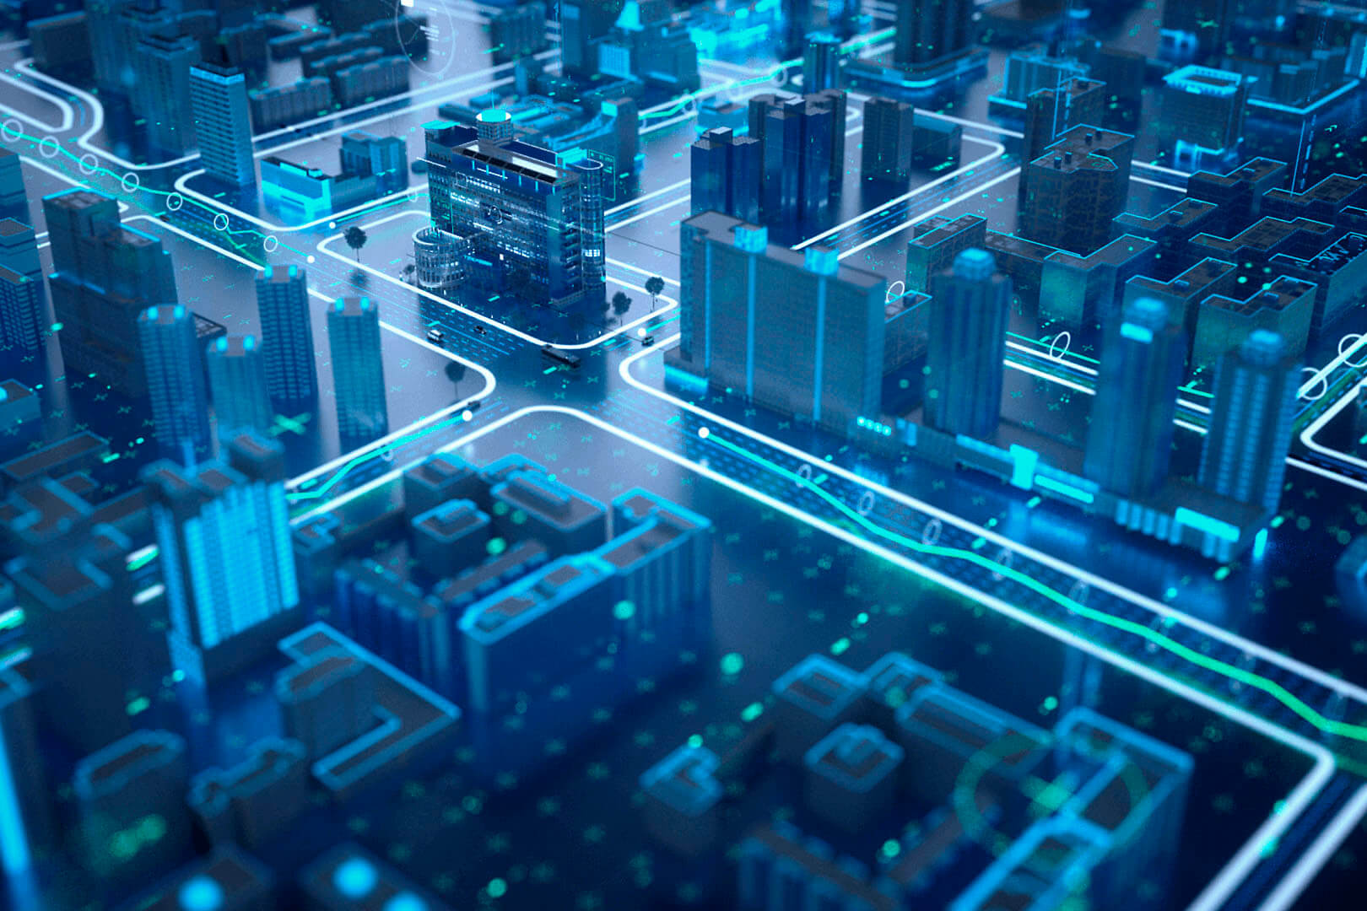
Thank you welcome to Neon

